Slide 1
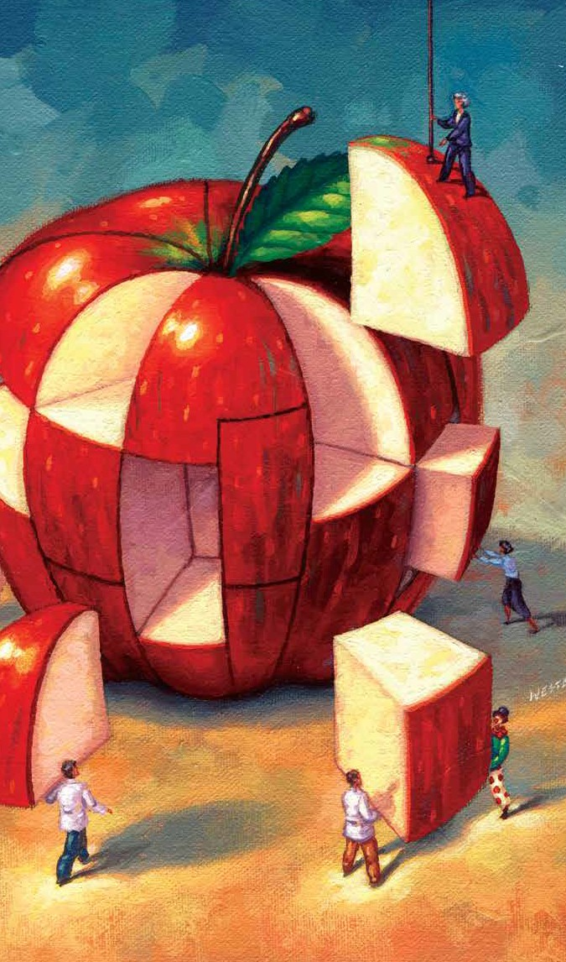
The Lawlor Group
Trends for 2018

Slide 2
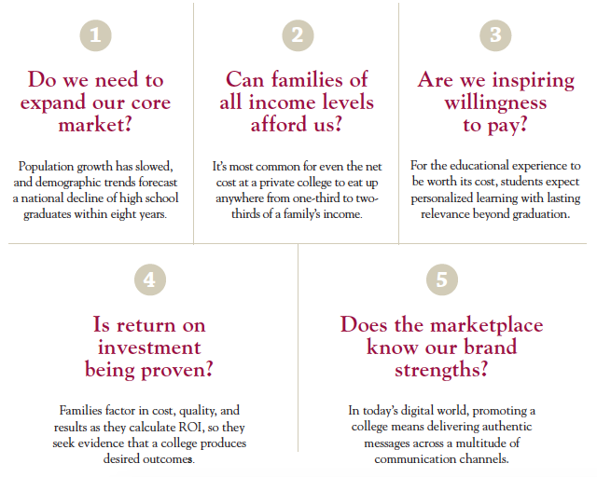
Five Questions the Higher Education Marketplace is Requiring Private Colleges to Answer
Trends for 2018

Slide 3
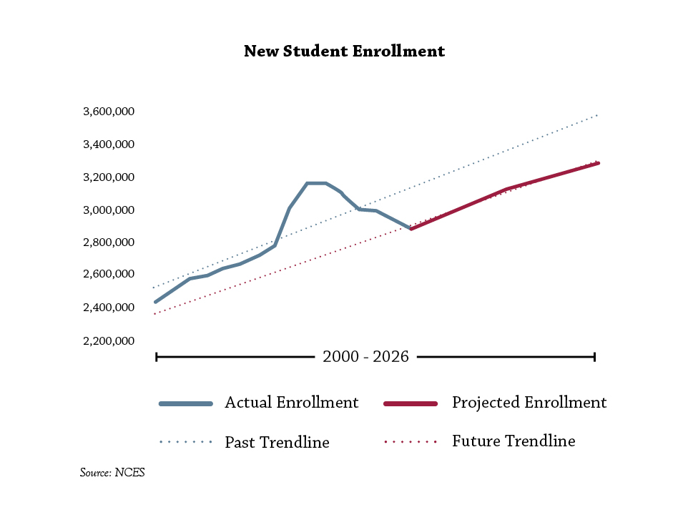
Gradual Enrollment Growth
Trends for 2018
In Fall 2022, enrollment of first-time degree/certificate-seeking students will recover its previous peak from Fall 2009, yet the future average growth rate will not produce as many additional enrollments compared to its past trajectory.

Slide 4
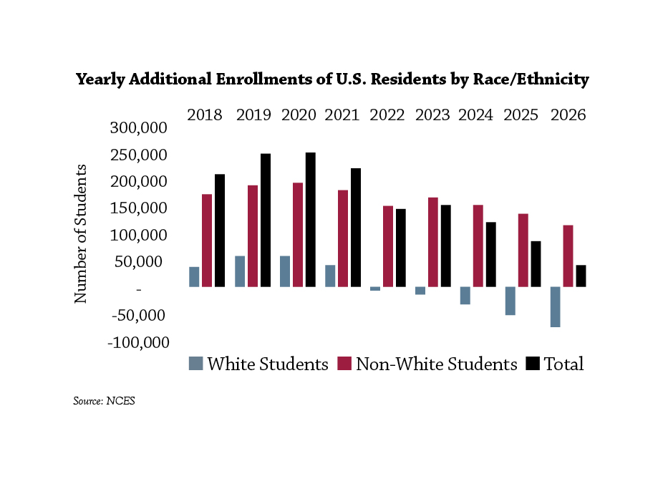
Increase in Racial/Ethnic Diversity
Trends for 2018
Students of color will account for 99% of the enrollment growth at degree-granting post-secondary institutions during the next nine years—50% of it from Hispanic students, 27% from Black students, 13% from students of two or more races, and 9% from Asian students.

Slide 5
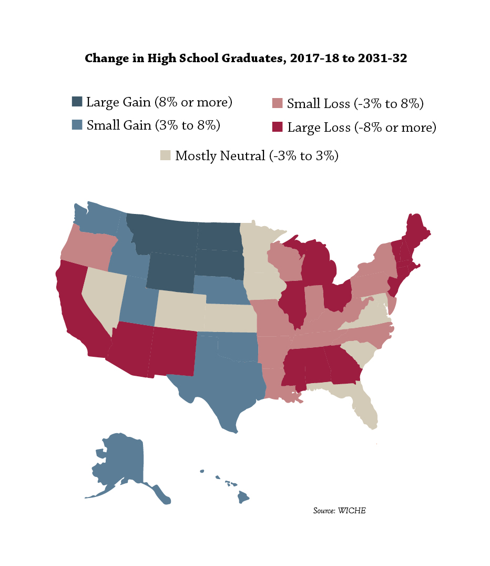
Variable Population Trends
Trends for 2018
Nationwide, the number of high school graduates will peak in 2024-25 at 2.9% higher than its current level, yet then will fall dramatically to 4.7% lower than now by 2031-32.

Slide 6
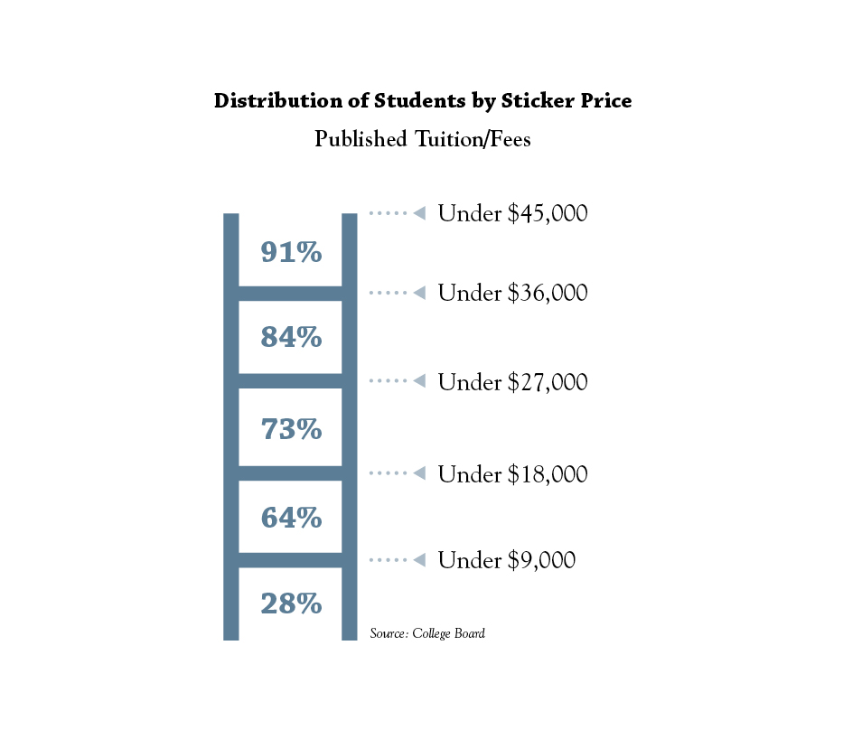
Small Market Share for High Price
Trends for 2018
A majority of full-time four-year undergraduates attend a college or university with published tuition and fees of less than $12,100. While the median sticker price for those attending a public institution is $10,270, at private nonprofit institutions it’s $35,260.

Slide 7
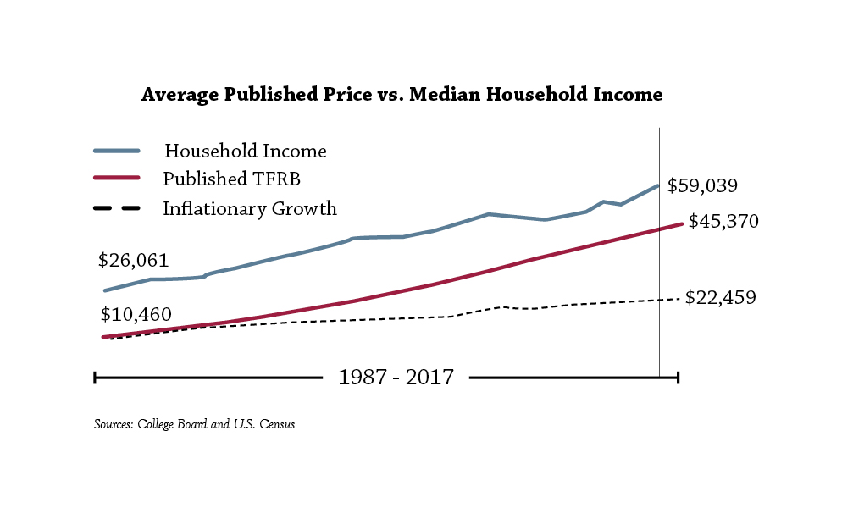
Price Growing Twice as Fast as Income
Trends for 2018
Thirty years ago, the average published price of tuition, fees, room, and board at private nonprofit institutions was 40% of the median household income. By 2016 it grew to 77%—although it would have been half that, 38%, if the published price had increased only at the rate of inflation.

Slide 8
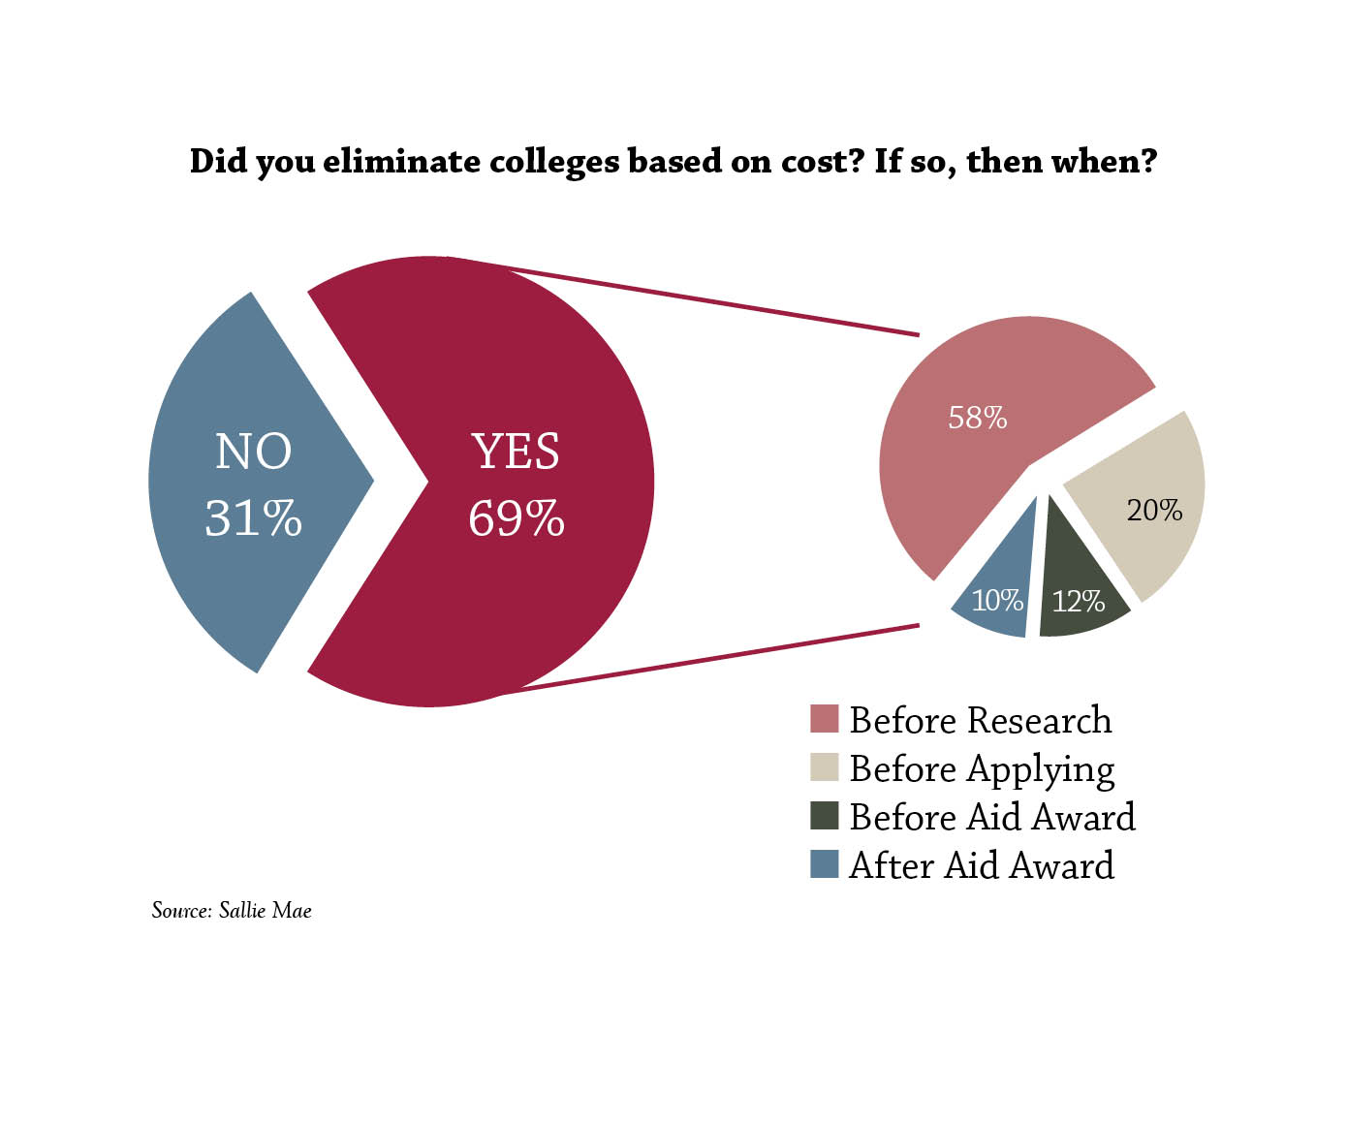
Sticker Shock is a Deterrent
Trends for 2018
Most families have crossed a college off their consideration list due to its published price before applying to it (likely, before knowing what their net cost would be).

Slide 9
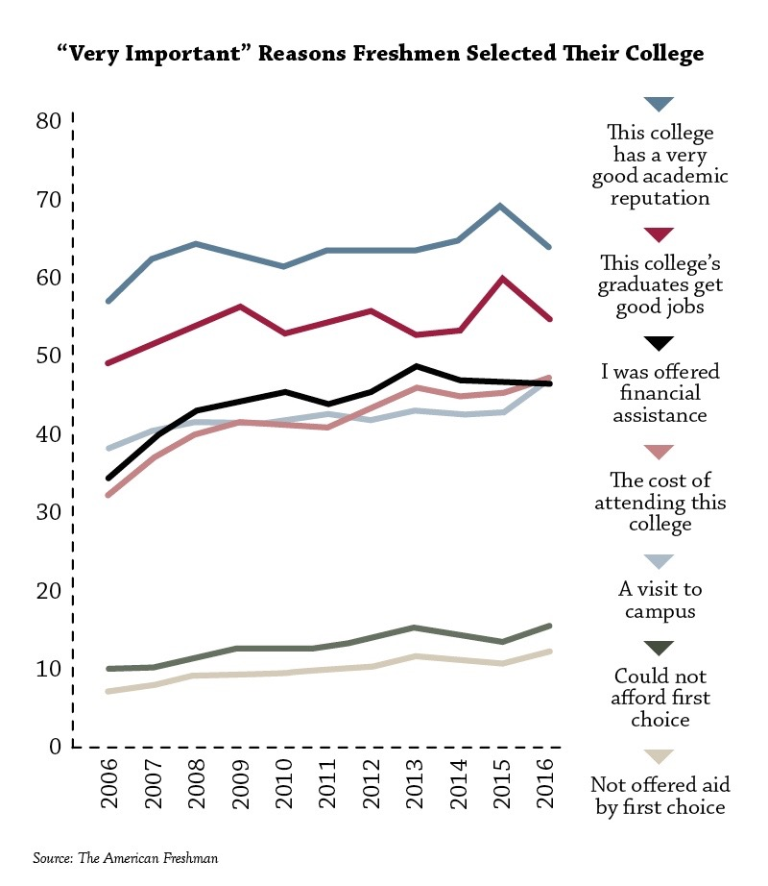
Economic Considerations Increasing
Trends for 2018
Sixteen of the choices among reasons for choosing a college have been consistently offered on CIRP’s survey during the past decade. The seven of them that have gained an average of at least half a percentage point per year are mostly focused on finances, with “the cost of attending this college” gaining the most.

Slide 10
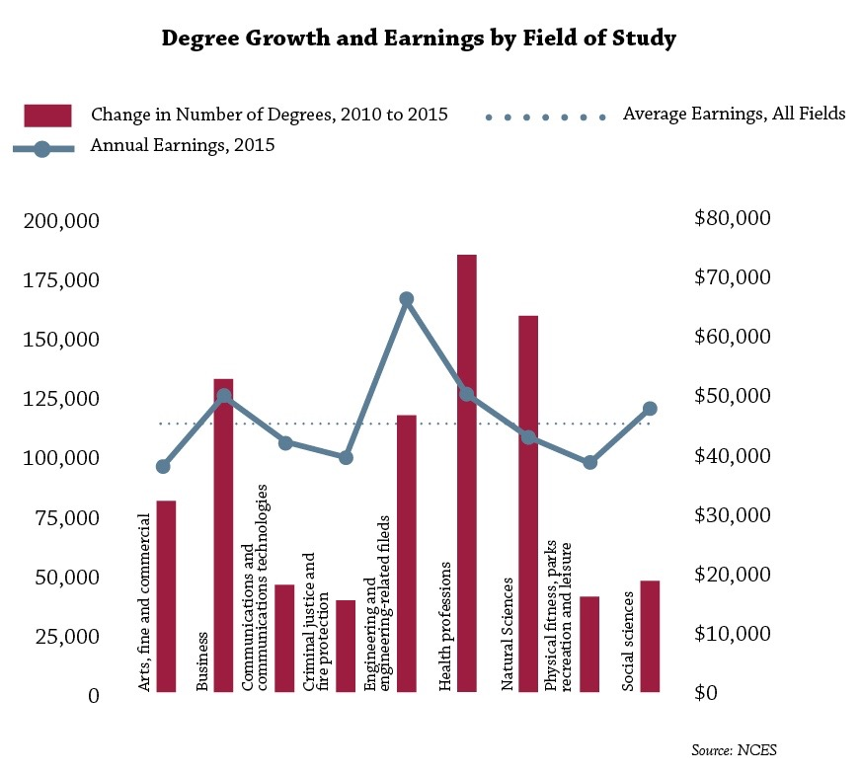
Growth in Majors with Higher Earning Potential
Trends for 2018
Nine categories of majors that were studied by college graduates aged 25 to 29 increased beyond the average of all majors between 2010 and 2015. Three of the top four gainers correlated with higher-than-average annual earnings in 2015 for 25- to 29-year-old graduates with that major.

Slide 11
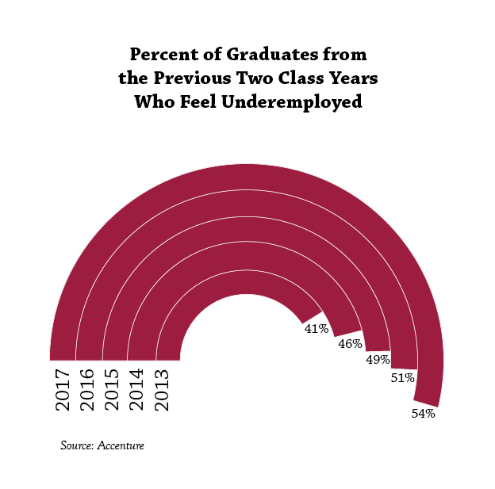
Employment Outcomes Often Disappointing
Trends for 2018
Although the job placement rate of college graduates has held steady during the past several years, graduates increasingly feel underemployed in jobs that are not taking full advantage of their college degrees.

Slide 12
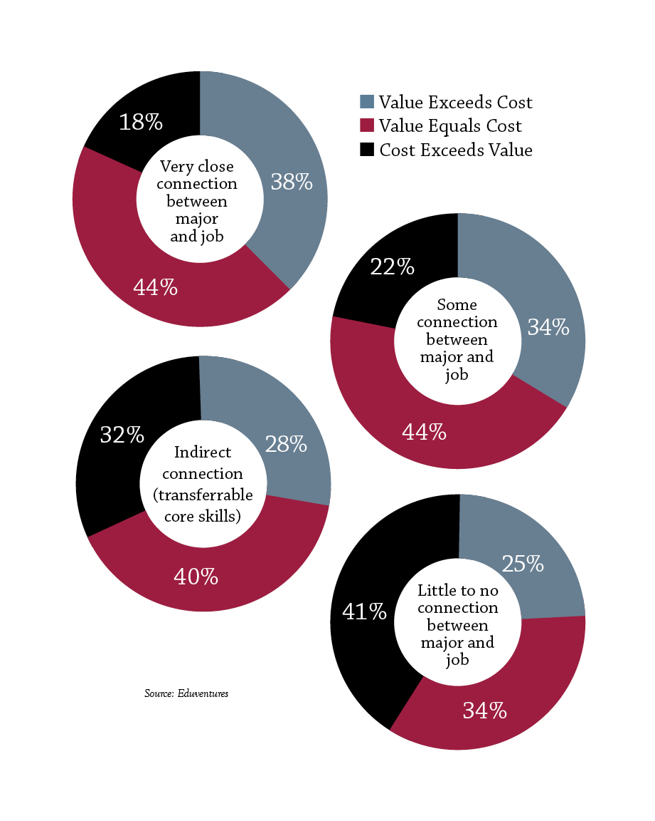
Career Relevance Adds Value
Trends for 2018
College graduates value their education more if their undergraduate major closely aligns with their current work, although 23% overall (40% among graduates from the last decade) believe their degree wasn’t worth its cost.

Slide 13
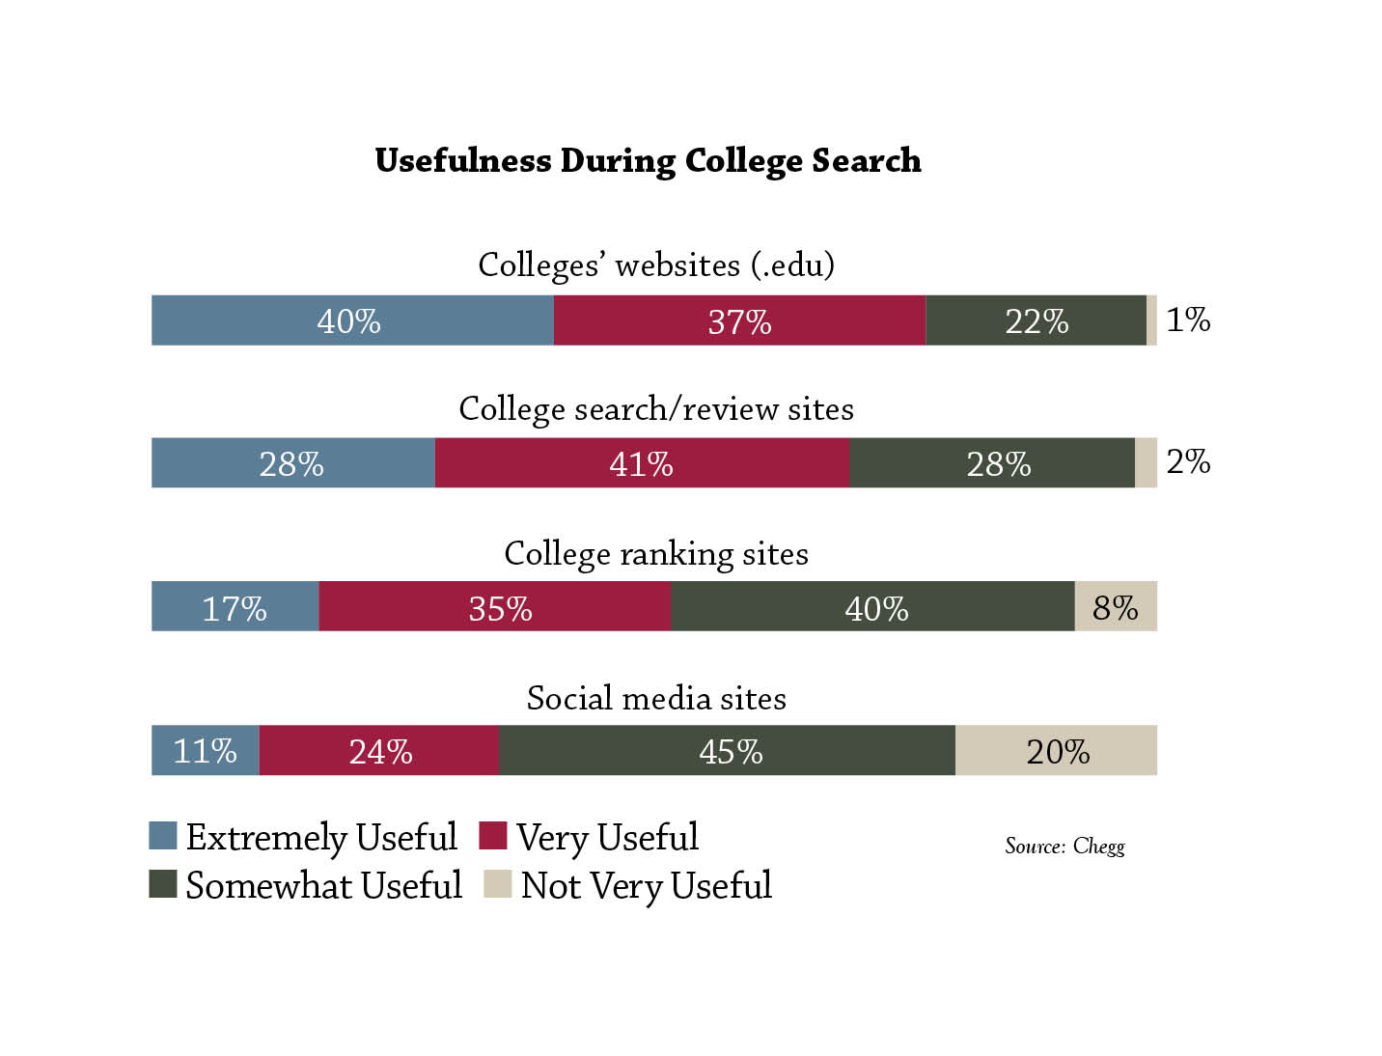
Online Sources Matter
Trends for 2018
During their discovery and information-gathering phases, prospective students are using a variety of digital tools to find and research colleges.

Slide 14
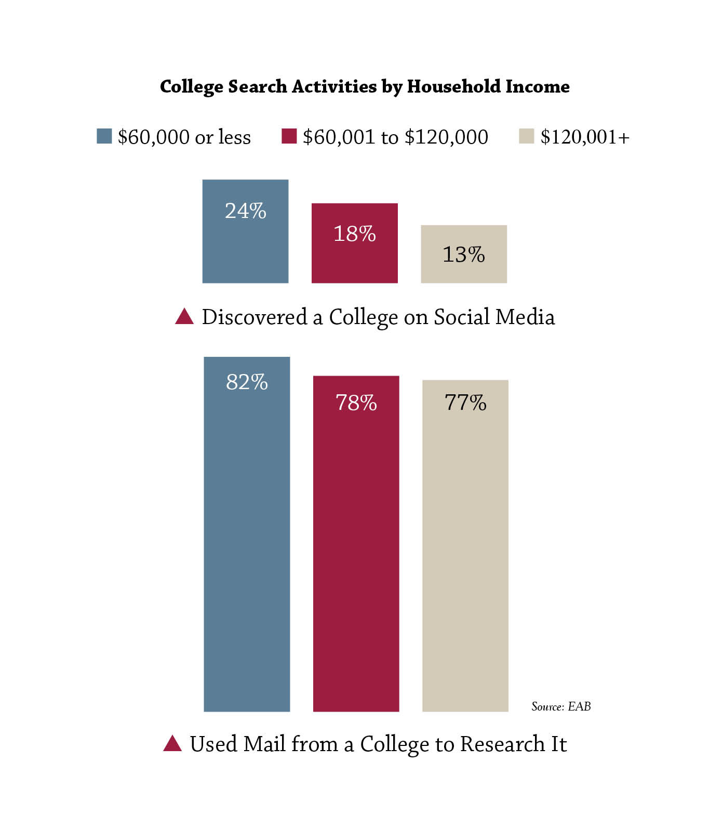
Communication Requires Multiple Channels
Trends for 2018
Students from lower income households are more likely to have first discovered a college of interest on social media—and they’re also more likely to use mail from a college to learn about it.

Slide 15
1.800.972.4345 | thelawlorgroup.com | tlg@thelawlorgroup.com

